Slide 1
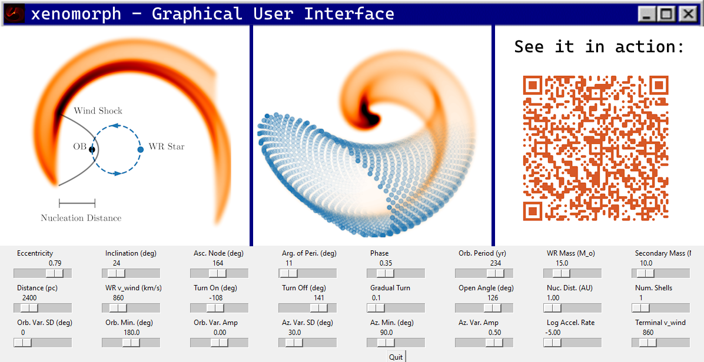


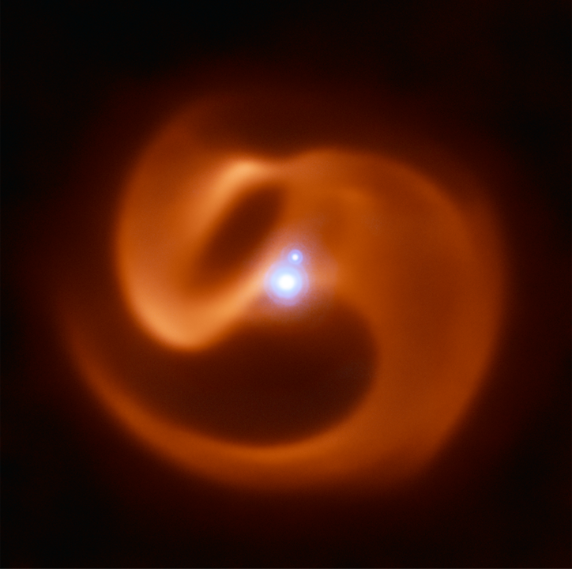
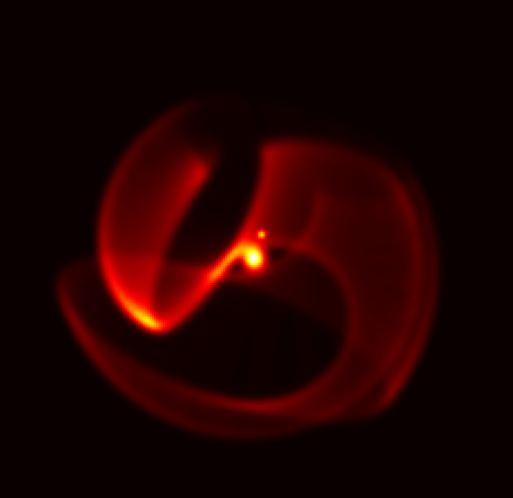



NSW AIP Research Poster Presentation Event April 7, 2025
xenomorph: the fastest way to model the colliding winds of massive binary stars
FOLDERS
Ryan White^{a@}, Benjamin Popeª, Peter Tuthill^{b}, Orsola De Marcoª
TITLE and AUTHORS
ª School of Mathematical and Physical Sciences, Macquarie University, N.S.W. 2109, Australia
^{b} Sydney Institute for Astronomy, School of Physics, The University of Sydney, N.S.W. 2006, Australia
@ ryan.white.astro@gmail.com
There are a handful of powerful Wolf-Rayet (WR) stars in close orbits with other massive stars, where the winds of both stars collide to form a bright spiral dust nebula¹. By modelling the shape of these nebulae, we can uniquely infer the orbits of the binary stars and many parameters about each stellar wind. This gives us an unparalleled view into the lives of the most massive stars, in particular those that are about to undergo a supernova explosion.
Here we present a brand new geometric code using the fast and differentiable JAX framework in order to model these nebulae and their parameters. With this, we may better understand these one-in-a-billion astrophysical laboratories and how they influence their environments.
MOTIVATION and
OBJECTIVE
METHODS
Stellar wind-wind collision results in a shock (black line in left panel) where dust copiously forms. At constant intervals in time, we create a ring of particles along the surface of this shock cone, then move those particles with the wind flow. The orbital motion of the binary then wraps these particles into spirals which resemble the nebulae we observe with telescopes.
xenomorph is 100x faster than previous codes, comes with a GUI, and is differentiable. We have also implemented more physics than ever before (e.g. radiative acceleration), making xenomorph truly the state-of-the-art tool for modelling colliding wind nebulae.
RESULTS (SO FAR)
We analysed with our code new Very Large Telescope and James Webb Space Telescope data of the only WR+WR colliding wind binary in the Galaxy: Apep². The image on the left shows the two stars (both unresolved in the central point of light) whose winds power the wider spiral nebula.
Our successful model on the right reproduces almost all of the observed geometry of Apep. The flexibility of our code also allowed us to model the dust destruction of a third star in the Apep system (bright point above the central source) which forms a cavity in the top right region of the dust shell!
Our model quantitatively shows that the system is weirder than previously thought, and pushes the boundaries of how we understand these colliding wind binaries.
Very Large Telescope Image
xenomorph Model
¹ R. M. T. White & P. Tuthill (2024) “Wolf-Rayet Colliding Wind Binaries”, arXiv:2412.12534
² J. R. Callingham, et al. (2019) "Anisotropic winds in a Wolf-Rayet binary identify a potential gamma-ray burst progenitor", NatAs, 3, 82
Download our book chapter:
Download this poster:

